Slide 1

Wine Quality
Mokhina Dustmurodova

Slide 2

01.
Data Cleaning and Preparation
784 duplicated values
(White Wine 3918 -> 3300
Red Wine 1279 -> 1113)
No null/NA data
Binary encoding without conversion (white wine 0; red wine 1)

Slide 3



02.
Exploratory Data Analysis
TOP 3 Factors with the strongest correlation with Wine Quality:
Alcohol (positive correlation)
Density (negative correlation)
Volatile Acidity (negative correlation)

Slide 4
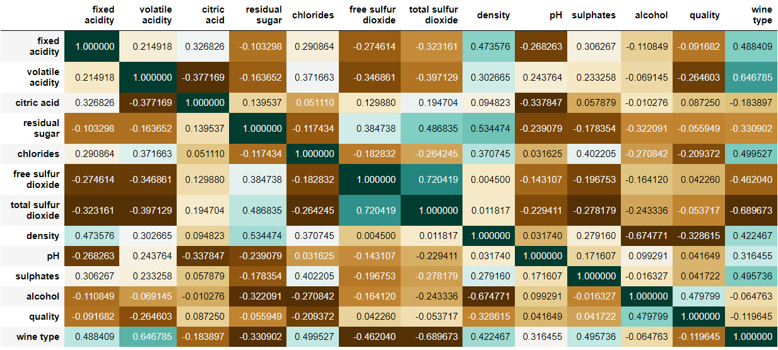

Slide 5
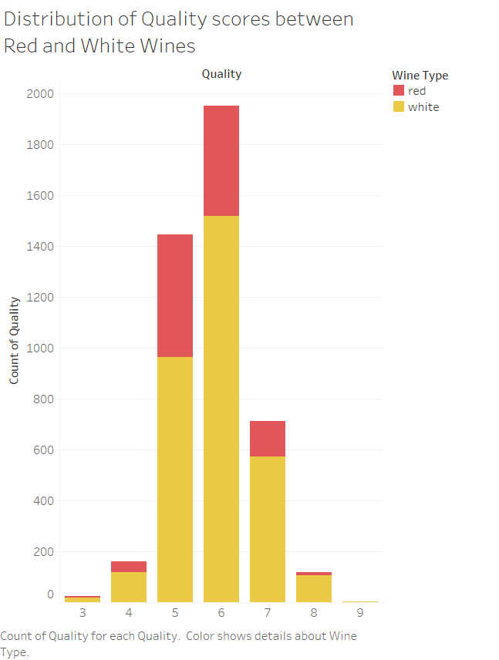
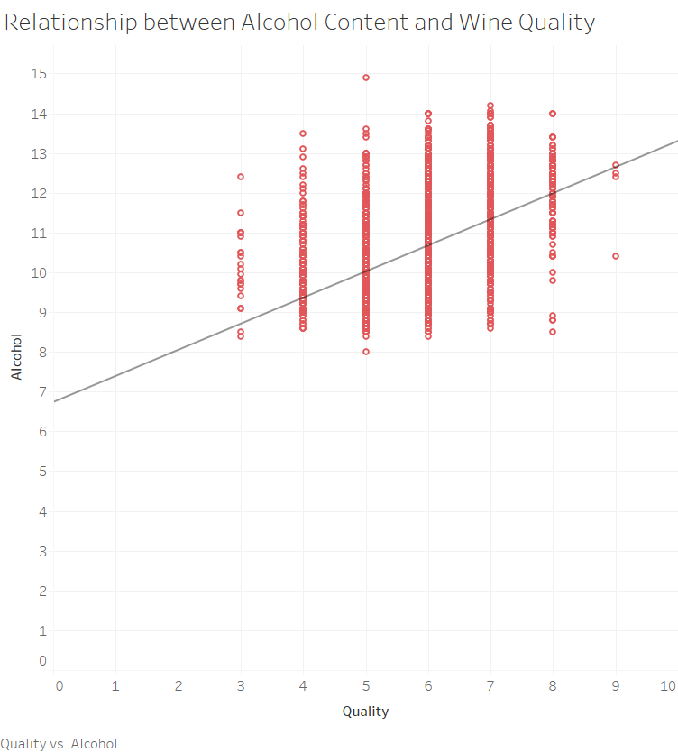

Slide 6
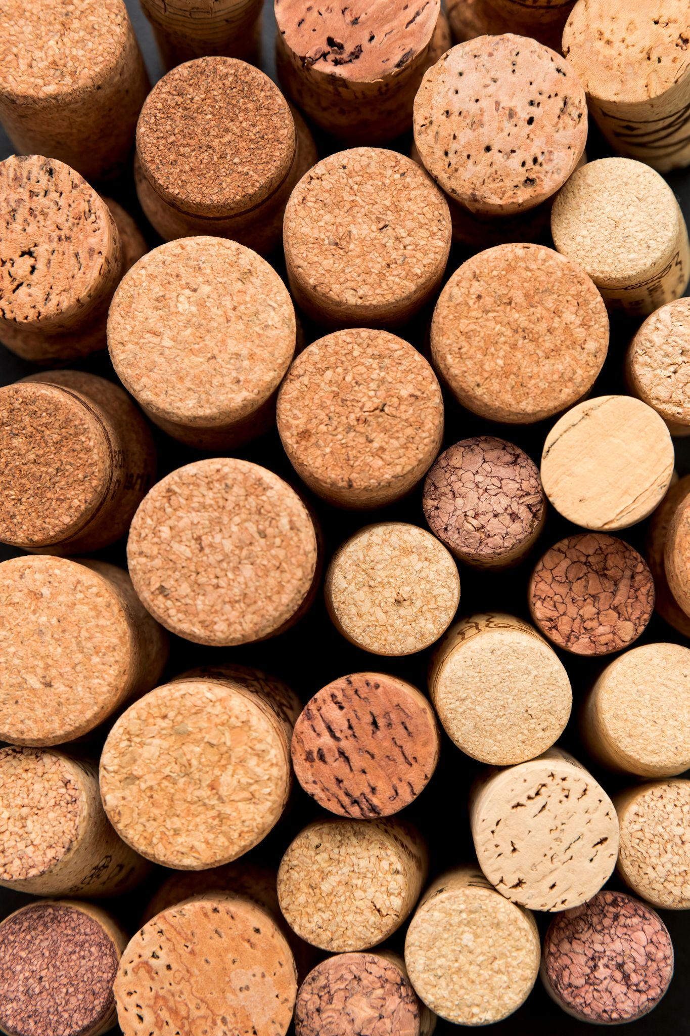

03.
Predictive Modeling
XL
Top Well-performed models:
Random Forests – 0.06
Decision Trees – 0.06
Gradient Boosting – 0.58

Slide 7
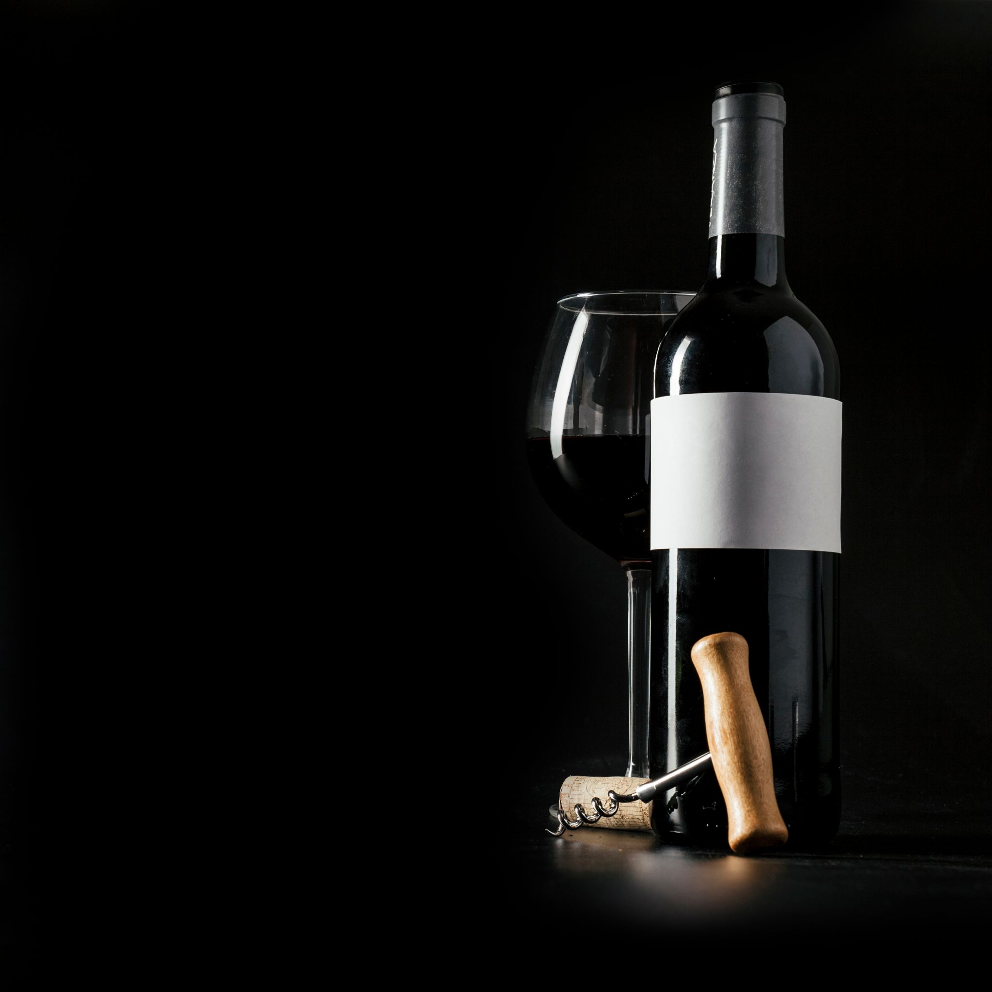
04.
Recommendations
Concentration on Red Wine Production;
Quality > Quantity in White Wine Production;
Increase Alcohol;
Decrease Density and Volatile Acidity;

Slide 8
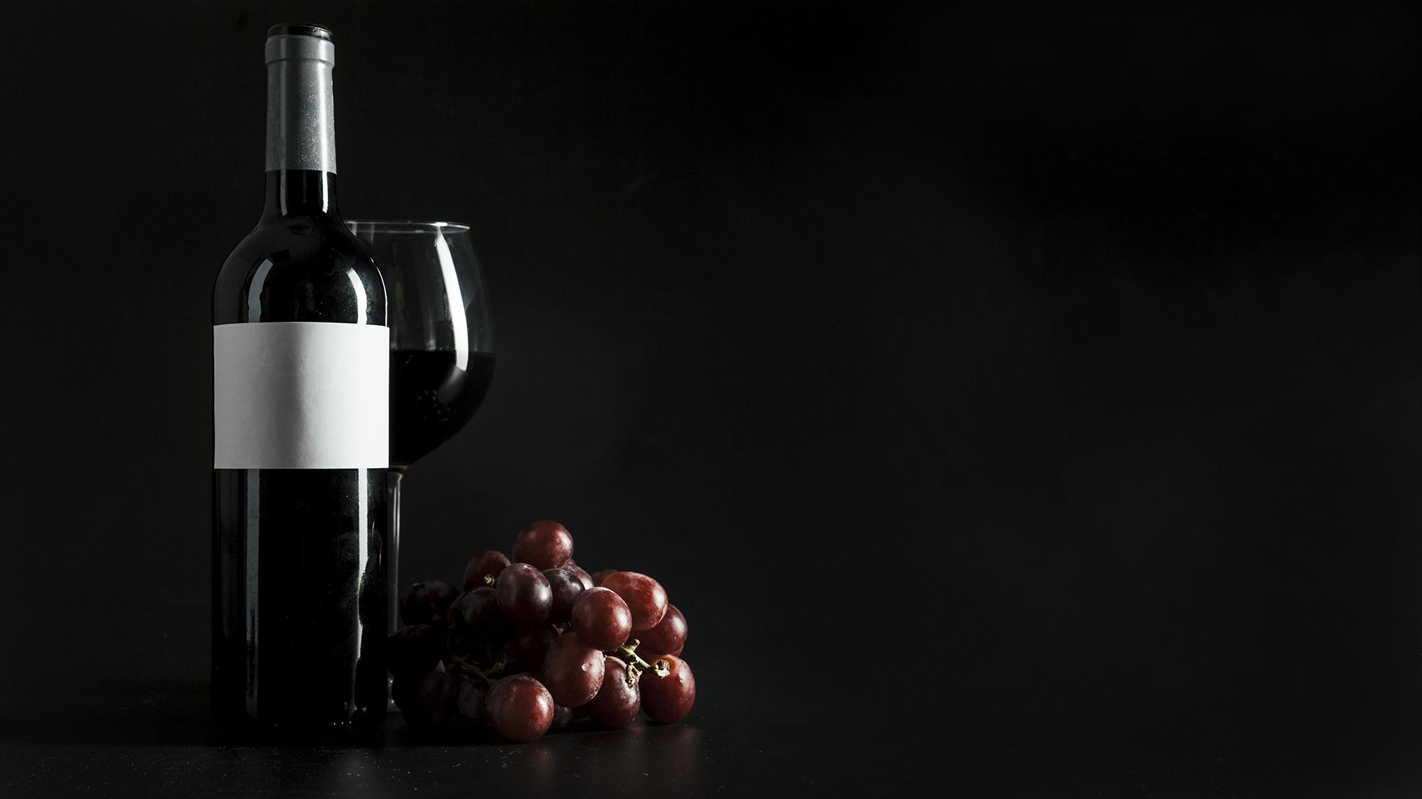
Thank You!
Improvements are on the way!

